Slide 1
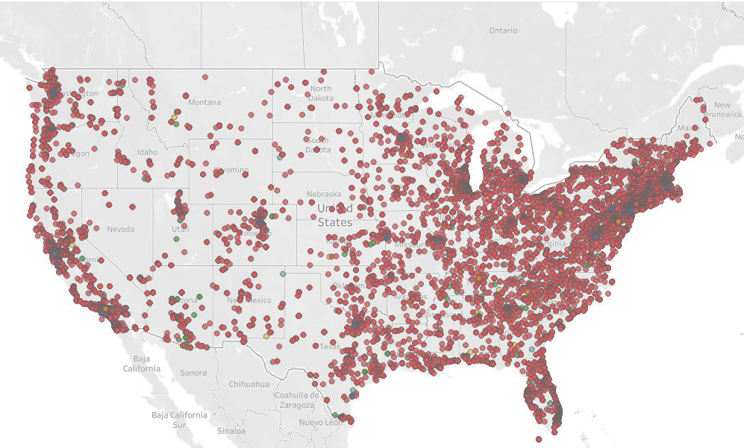
Team Number:
IC22011
Dataset:
The Armed Conflict and Event Project
UMD Information Challenge 2022
MIDN 2/C Jeff Peters
MIDN 3/C Clay Fiscus
MIDN 3/C Matthew Lewis
MIDN 3/C Julian Muniz

Slide 2
Presentation Agenda
The Problem
The Data
Analysis
Conclusions
Recommendations
Future Work
Notes:
This is a guideline, can be changed as we go.

Slide 3
The Problem
How has the number of events changed over the period from 01/01/2020 to 01/21/2022?
Are there any significant specific locations/metro areas that have changed more than others?
How have the types of events changed over the period?
Are certain types of events more prominent in specific areas?

Slide 4
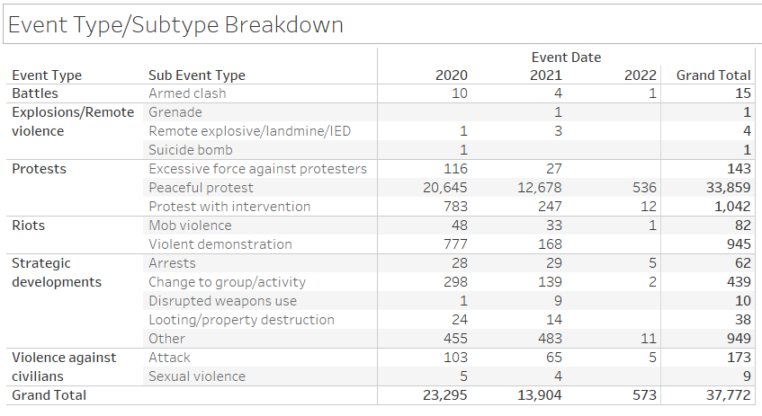
The Data
Period Covered:
01 JAN 2020 - 21 JAN 2022
37,772 incidents related to protests and political/targeted violence
89.6% peaceful protests
2.8% protests w/ intervention
2.7% riots
<1% each remaining category
We included state population data from the census bureau to normalize the incident counts

Slide 5
Data Concerns
Categorization of events is subjective to an extent
peaceful protest -> violent demonstration -> mob violence
Data is given in absolute terms i.e. not adjusted for population
To what extent can trends be attributed to specific world events
Are spikes coincidences or reactions?

Slide 6
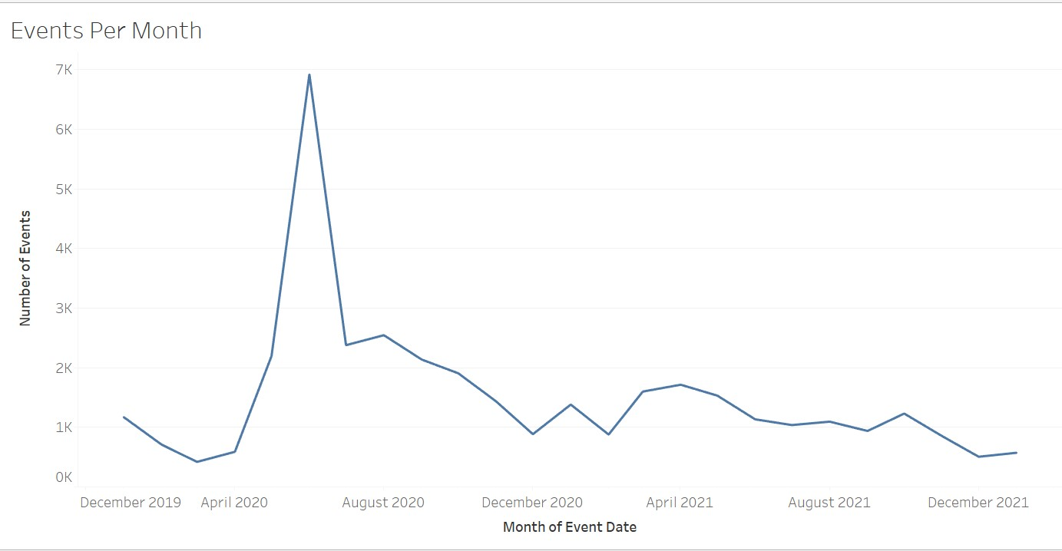
Total Events Over Time
Noticeable Spikes
June 2020
Appears to correlate with the death of George Floyd
January 2021
Appears to correlate with the counting of electoral votes on 06 JAN
April 2021
Appears to correlate with the death of Daunte Wright
October 2021
Appears to correlate with Texas abortion law passage

Slide 7
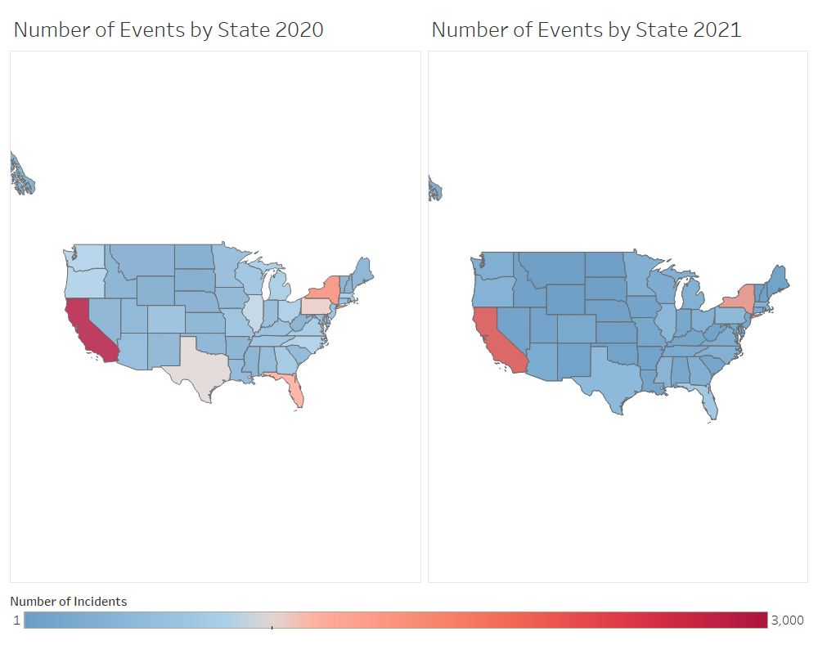
Changes Over Time by Location
High Population states have the most incidents…

Slide 8
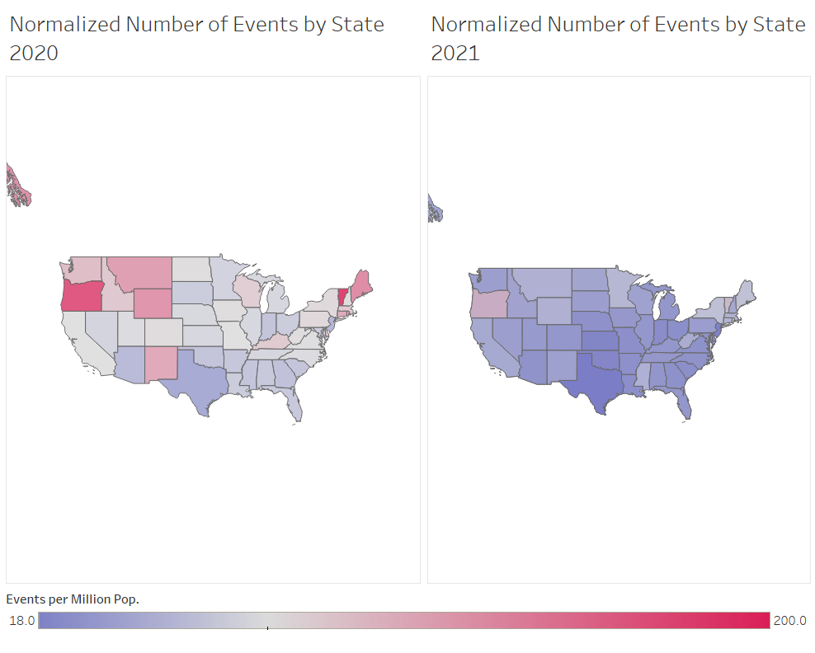
Adjusting for Population
After adjusting for population, differences by region become clear
Large decrease in number of events from 2020 to 2021.
Mainly due to June 2020 spike
Decrease was roughly equal across all states
Above average states remain above average

Slide 9
Regional Changes
Spikes in events were evenly distributed across the United States population centers
Largest spikes seen in major metro areas
Very few protest movements were constrained to a particular area

Slide 10
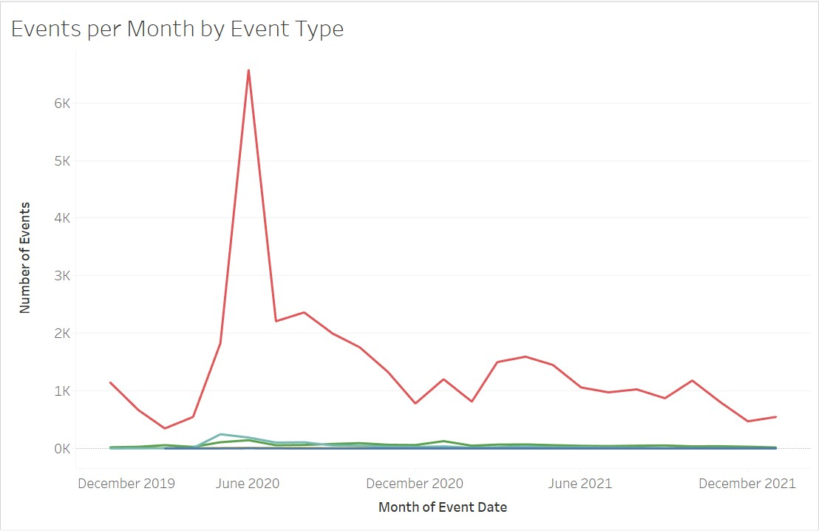
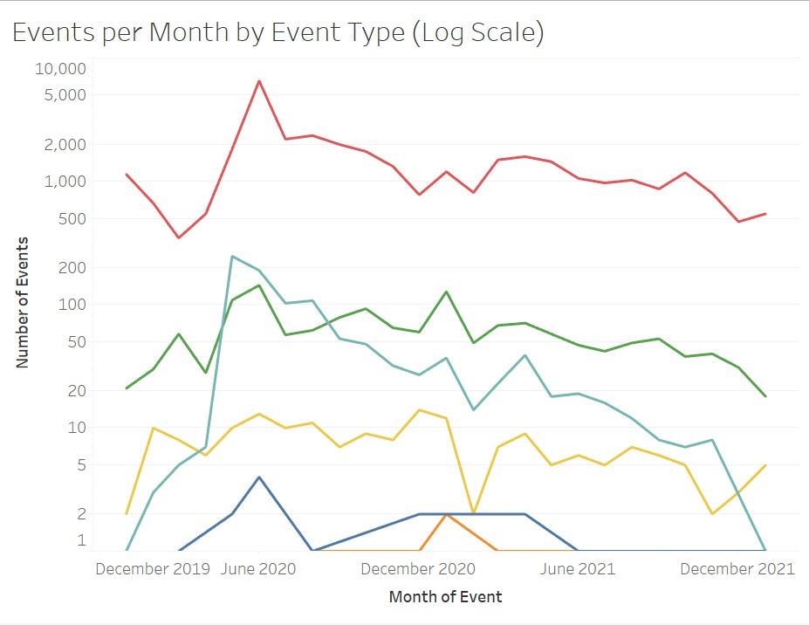
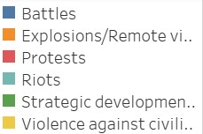
Types of Events Over Time

Slide 11
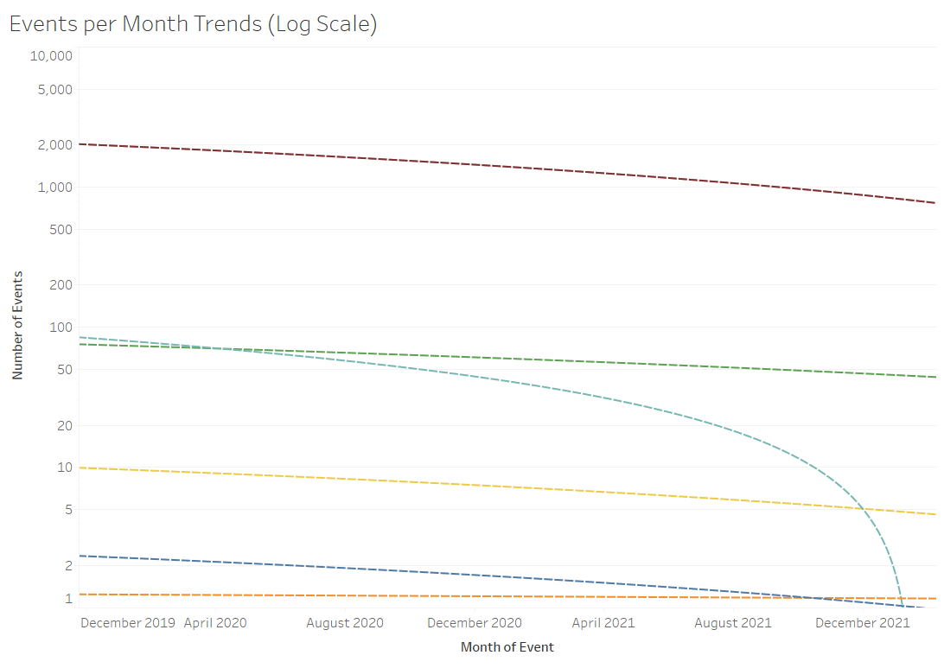
Event Trends
Riots increased the most proportionally during the June 2020 spike
Riots also decreased the fastest of any event type
All other events drop proportionally from peak in June 2020

Slide 12
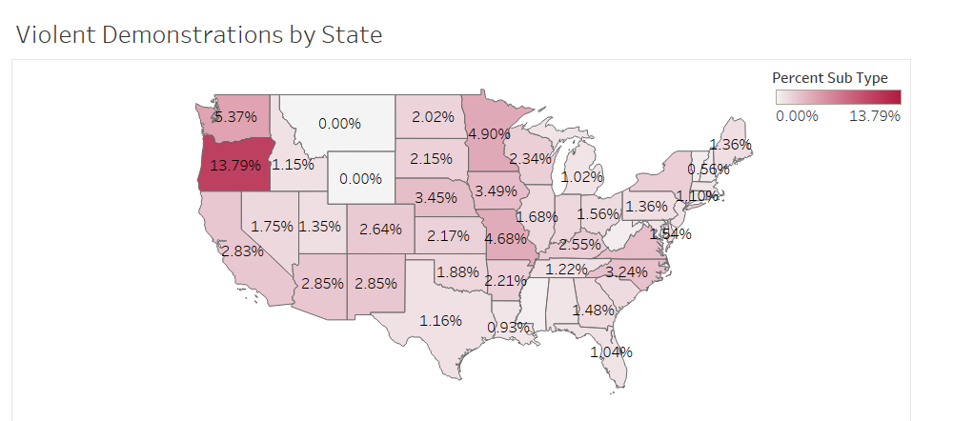
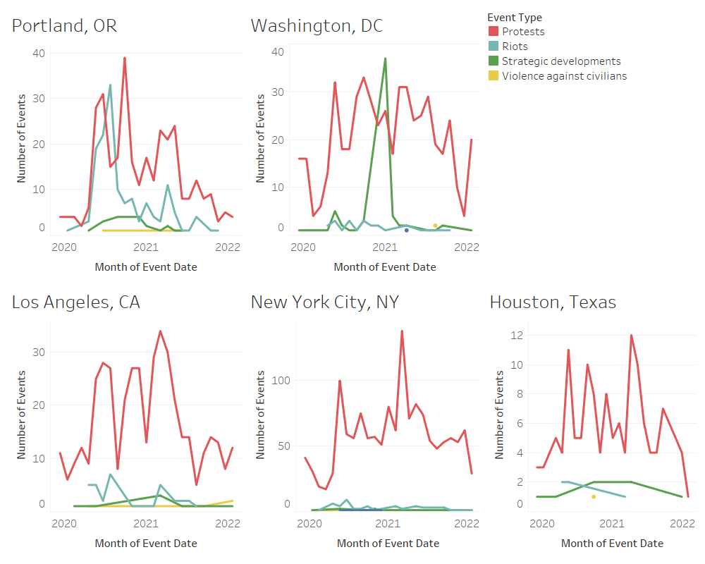
Notable Locations
Particularly high proportion of violent events in Oregon
Portland metro area had the highest proportion of violent events among studied locations
DC had a large spike in strategic developments in JAN 2021
Arrests and National Guard Deployments
NYC, like much of the northeast, had many protests but little violence

Slide 13
Conclusions: Revisiting the Problem
Change in total events over time
Spikes in data correlated with known nationwide events
Regional changes over time
Spikes in different regions were heavily correlated
A change in total events in one state was unlikely to be an isolated response
Types of events over time
During periods of unrest, violent events rise at the fastest rate; however, they also fall at the fastest rate as time goes on.
Events types by region
Large number of events and violence in Pacific Northwest
Large number of events but low violence in Northeast
Low number of events and low violence in the South

Slide 14
Recommendations
This data can be used to determine locations that are most likely to undergo violent events in response to nationwide unrest.
Future violence can be mitigated or prevented by focusing law enforcement on areas of concern determined by our findings.

Slide 15
Future Work
Although our conclusions were revealing, the limited time frame of the competition leaves us with several avenues for continued research.
For one, we could use our results to specify cities within states that we noticed as particularly violent, potentially providing more accurate conclusions.
Another potential opportunity could be looking more into the ripple effects caused by controversial events, as several we examined had lasting impacts on the number of protests and other types of events measured.

Slide 16
Resources
Graphics generated using Tableau Desktop
Population Data:
Bureau, U. S. C. (2021, October 8). 2020 census apportionment counts press kit. Census.gov. Retrieved March 5, 2022, from https://www.census.gov/newsroom/
press-kits/2021/2020-census-apportionment-counts.html

Slide 17
Questions?

Slide 18
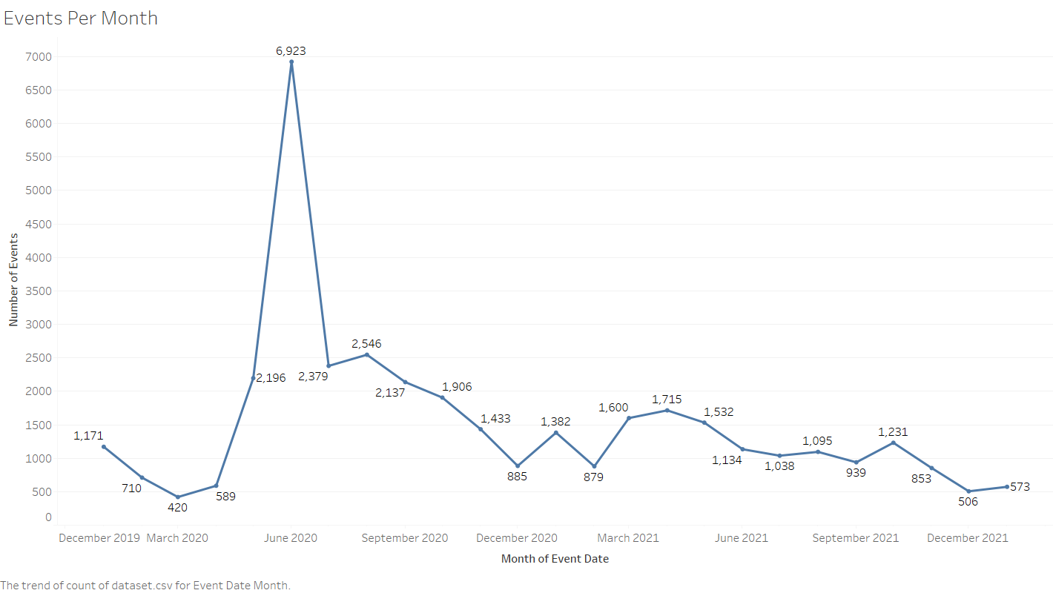
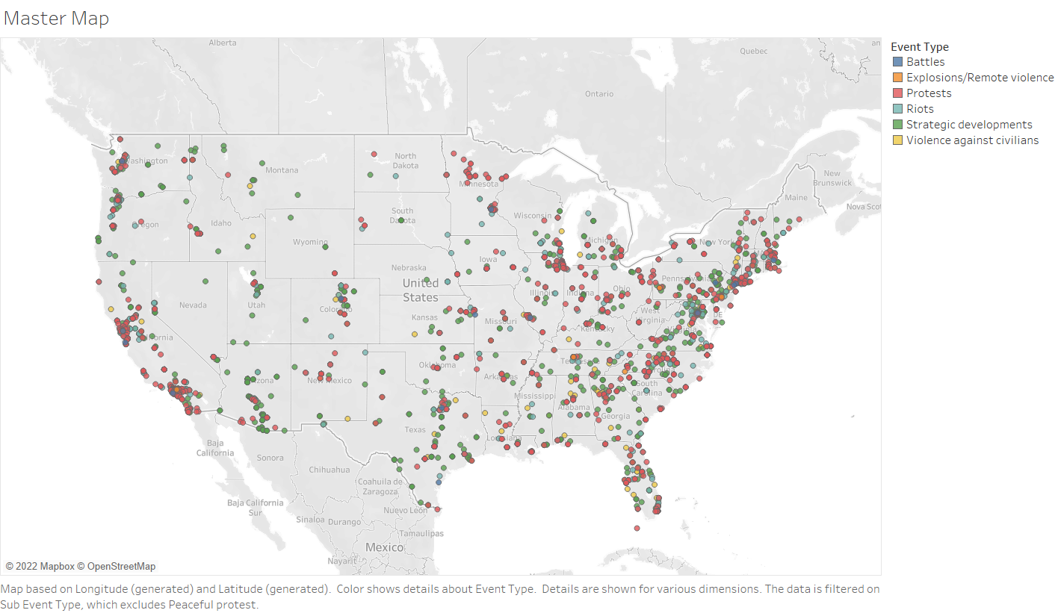
Additional Slides

